Slide 1
Robust Equilibrium and Fast Numerical Solution to Wide Varieties of Games
Li, Hongcheng

Slide 2
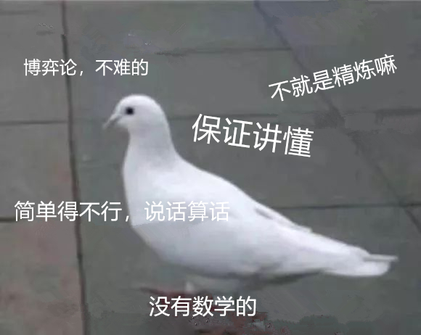

Slide 3
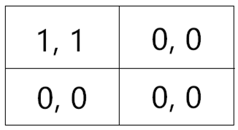
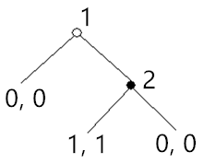
Why Refinement?
The definition of Nash Equilibrium is not enough.
Two relevant aspects: different but correlated
Weak Domination & Time Inconsistency

Slide 4
Literature of Trembling
Selten(1965): Subgame-Perfect Equilibrium
Harsanyi(1973): Trembling Payoff
Selten(1975): Trembling Hands -> Perfect Equilibrium
Kreps and Wilson(1982): Extensive Form -> Sequential Equilibrium
Myerson(1978): Proper Equilibrium
Kohlberg and Mertens(1986): Stability of Equilibria
Others...Persistent, Justifiable, Intuitive, Divine, Undefeated Equilibrium...

Slide 5

Literature of Trembling
Perfect Equilibrium: If there exists one path of A's opponent's strategy within totally mixed space converging to the present strategy, and A's strategy endures every strategy on this path, then A's strategy is perfect. If each strategy is perfect, they form a perfect equilibrium.

Slide 6
Robust Equilibrium
How to define robustness of equilibria?
anticipation of one's opponent's strategy
this one's strategy is almost surely definite.
Therefore, to define robustness of anticipation should be necessary before defining that of an equilibrium.

Slide 7
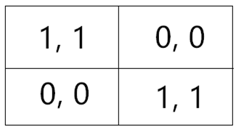
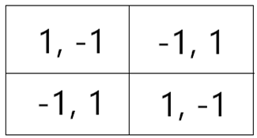
Robust Equilibrium
Definition(only intuitive here): The anticipation of one player A's opponent B's strategy is robust, if this anticipation endures any sufficiently slight perturbation, conditional on A's immediate best reaction to these disturbances.
e.g.

Slide 8
Robust Equilibrium
Payoff function
Reaction function
Decision function
Definition: I name the following function
as the General Decision Function(GDF).
Anticipation!!!

Slide 9
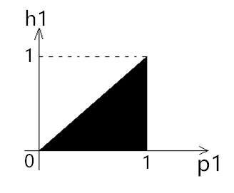
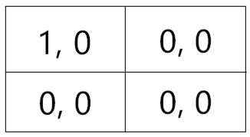
Robust Equilibrium**
Lemma: GDF is a single-valued function and is nonempty; and as well amost surely continuous and differentiable, given the game is finite.
***Remark: Why adding a 'max' in the front?

Slide 10
Robust Equilibrium**
For any , we can further define the Perturbation Form of GDF as
Intuitively, this perturbation form provides the payoff that A can get, with the extent of deviation, , from to , conditional on immediate best reaction of B.

Slide 11
Robust Equilibrium**
Definition: The anicipation of A, , is robust, if for any , the corresponding perturbation form of A's GDF is nonincreasing on some positive deleted neighborhood.
Namely, there exists some is nonincreasing on the domain .
***From a robust expectation, we can derive a robust equilibrium.

Slide 12
Robust Equilibrium
Ultimate insight:
To carry out rationality in a game is mainly about anticipating opponent's behavior. And those 'good' anticipation need to endure perturbations.
The difference between robust and nash is the definition of 'endure', namely, whether the player who anticipates reacts to perturbation.

Slide 13
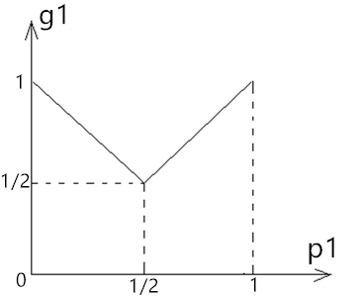
Robust Equilibrium
No more crazy notations and definitions!!!

Slide 14
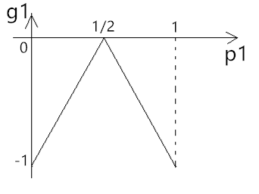
Robust Equilibrium

Slide 15
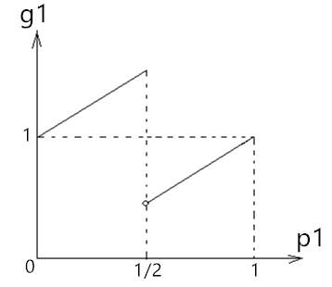
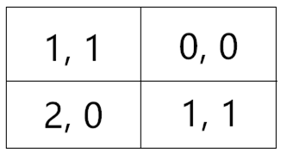
Robust Equilibrium
Proposition(not strict here): If the game is finite, an anticipation is robust, if and only if it is a 'deleted' maximal point of GDF .
***Why 'deleted'?

Slide 16
ε-Robust Equilibrium**
To extend the concept of robust equilibrium into the areas of multi-player game and dynamic game, a technique called ε-Robust Equilibrium is used which narrows the strategy space, , by removing a 'shell' with ε-thickness from the original space, and consequently the new space only contains totally mixed strategy points. We can find all the deleted maximal points on this ε-domain, and we donote the set of these ε-robust equilibria as . When ε→0, converges to the equilibrium set that we want.

Slide 17
Interesting Propositions
Proposition: In finite games, any robust equilibrium is nash equilibrium.
Proposition: In any finite game, there exists at least one robust equilibrium.
Proposition: In finite games with perfect recall, any ε-robust equilibrium is perfect(or even proper) equilibrium.

Slide 18
Why is this Definition Important?*
Disadvantages of previous definitions:
1.Can not provide straightforward economic insight.
The definition of Selten's Perfect Equilibrium:“...if there exists one path...”, where the word 'exists' is confusing, for a well-defined robust equilibrium need to tolerate 'for all'.
Many following studies (e.g. Kreps and Wilson, 1982) find out that Perfect Equilibrium is not completely about trembling. Thus, the original definition given by Selten is not direct enough. And other refinements that followed have not seriously consider this problem.

Slide 19
Why is this Definition Important?*
Perfect Equilibrium: If there exists one path of A's opponent's strategy within totally mixed space converging to the present strategy, and A's strategy endures every strategy on this path, then A's strategy is perfect. If each strategy is perfect, they form a perfect equilibrium.

Slide 20
Why is this Definition Important?*
The literature of trembling is not about trembling!!!

Slide 21
Why is this Definition Important?*
Disadvantages of previous definitions:
2.Are not mathematically tractable.
Previous literature only provides some concepts and piles of proofs, which are all complicated and not tractable. Whereas in this article, I offer a complete method, namely by exploring the 'maximal points' of GDF, to find all of this kind of specifically defined equilibria.
3.Can barely be utilized in application problems.

Slide 22
Fast Numerical Solution
The most exciting property of Robust Equilibrium is that all such equilibria can be derived from the Deleted Maximal Points of General Decision Function.
As we all know, we can use 'noisy' gradient ascent algorithm to find deleted maximal points of a function almost surely differentiable.

Slide 23
Fast Numerical Solution
Proposition: Any numerical game that can be expressed in finite form is solvable via this algorithm.
***Multi-player or dynamic game: ε-method...
***Continuous strategy space: deep neuron networks...
This provides a very important potential application of Robust Equilibrium. This will give scholars opportunities to consider much complicated economic settings. Moreover, the possibility of computing games with continuous strategy space is also helpful in studying applied micro-economic theory.

Slide 24
Fast Numerical Solution
Console:
Warning: input game too simple
A trivial game:
{
E1=[0,0],
E2=[1,1]
}
from GameTheory.robustEqui import solve
import numpy as np
if __name__ == '__main__':
Game = np.array([[[1,1],[0,0]],
[[0,0],[1,1]]])
print('A trivial game:\n', solve(Game))

Slide 25
Thank You

